Slide 1
THE POWER OF
ADDING AND MULTIPLYING
Conceptually the idea of area is simply
“the product of two linear dimensions”
The notion of Riemann Sum is then an extension of this idea to more general situations. However, in the formula
could be anything, and so could and !
For example, I could write the same formula as
and you will think of ….. ?

Slide 2
That’s right,
suggests
istance = elocity ime !
(which happens to be correct.) What do Riemann sums have to do with this? Well, if the formula
Is re-written as

Slide 3
We get a different interpretation of Riemann sums, as istance covered. For example,
suppose you have a camcorder in your car that can make a tape of your speedometer reading.
You want to measure the accuracy of your odo-meter, as well as your mpg rating. so you start with a full tank (25 gals.) and drive till you run out of gas. You drive somewhat erratically, with lots of slowing down and speeding back up to really ensure an accurate measurement. You get a tape
like this (Newton first thought of this problem)

Slide 4
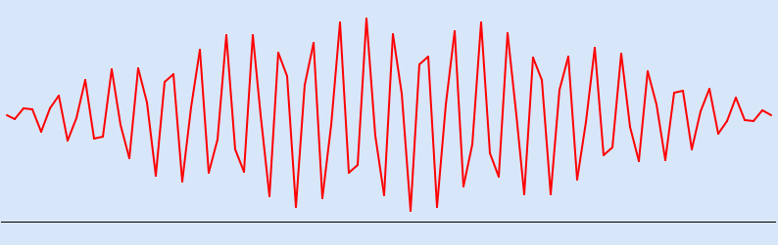
and somehow from the tape you should recover the distance you have traveled, so you can compare with your odometer and also get your mpg (= distance traveled/25gals.)
The formula
says that you can apply Riemann sums to the tape

Slide 5
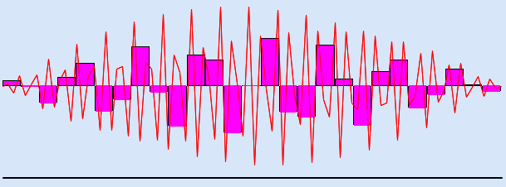
(one approximation with is shown, those rectangles you don’t see have zero height.)
We have discovered that
(Remember that, so far, the symbol
just means the limit of Riemann sums.)

Slide 6
FUNDAMENTAL THEOREM OF CALCULUS
It’s high time we address the matter you all have studied in High School, the formula
namely “to compute an integral just find an anti-derivative.”
Unfortunately, as stated the formula is wrong, it needs a little more precision.
To begin with, let me show you why it is wrong.
Here is an example:

Slide 7
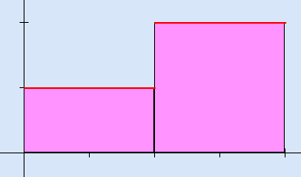
If we compute
for the function shown in the figure we get
(simple geometry, check it out !)

Slide 8
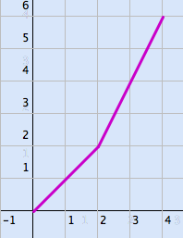
The graph of Is as shown below
Clearly does not exist at QED.

Slide 9
Let us make a precise statement:
Theorem. Fundamental Theorem of Calculus. Let
be continuous. Then the function defined by
is differentiable for every
and .
Note: we use not to confuse it with .
We delay the proof of the theorem for now and proceed instead to state its most useful

Slide 10
Corollary. Let be continuous and let be such that
Then
The proof of the corollary is straightforward, because both and have the same derivative over , so they differ by a constant, and

Slide 11
Remark. The beauty (and power, and depth) of the Corollary is that it reduces the computation (usually quite difficult) of limits of Riemann sums to the much more amenable (though at times frustrating !) task of finding just one anti-deriva-tive ! The statement of the corollary does not require that be found in some specified way, only that .
Your kind grandma, or your roommate or, most often, some appropriate table will tell you what
is, and then you are off to the races !
Let’s prove the theorem.

Slide 12
We have to show that
Let
Then we have to show:
We do the case . Look at the figure

Slide 13
The figure should be self explanatory. Do not be
deceived by the figure, we do know (from conti-nuity and the Extreme Value theorem) that

Slide 14
achieves a minimum and a maximum on
, but they need not be at the end-points, a blown-up figure might look like this:

Slide 15
In any case, however,
or
On other words, is some number between and .
By the Intermediate Value theorem, that number
is achieved by the function somewhere between

Slide 16
and , that is, for some
we have (number)
Therefore
by continuity.
QED
Let me stress again that without continuity the theorem is false !
Now we start examining how to cook up anti-derivatives.

